Slide 1
Chapter 5: Understanding Requirements
Course Supervisor: Syeda Nazia Ashraf
Software Engineering: A Practitioner’s Approach, 7/e
by Roger S. Pressman

Slide 2
Requirements Engineering-I
It encompasses seven tasks. Some tasks can occur in parallel.
Inception—ask a set of questions that establish …
basic understanding of the problem
the people who want a solution
the nature of the solution that is desired, and
the effectiveness of preliminary communication and collaboration between the customer and the developer
Elicitation—elicit requirements from all stakeholders
Elaboration—create an analysis model that identifies, expand and refine data, function and behavioral requirements. Driven by user scenarios that describe how the end users and other actors will interact with the system.
Negotiation—agree on a deliverable system that is realistic for developers and customers

Slide 3
Requirements Engineering-II
Specification—can be any one (or more) of the following:
A written document
A set of graphical models
A formal mathematical model
A collection of user scenarios (use-cases)
A prototype
Validation—a review mechanism that looks for review team to find errors in content or interpretation
errors in content or interpretation
areas where clarification may be required
missing information
inconsistencies (a major problem when large products or systems are engineered)
conflicting or unrealistic (unachievable) requirements.
Requirements management— Requirements change and the desire to change persists throughout the life of the system. Help the project team identify, control and track requirements and changes to requirements at any time as the project proceeds.

Slide 5
Inception: Establish the Groundwork
Identify stakeholders (who benefit directly or indirectly from the system)
“who else do you think I should talk to?” is asked for every stakeholder
Recognize multiple points of view and category.
Work toward collaboration within stakeholder and with SE PR actioners. Identify areas of commonality and conflicts. (priority points for requirements)
The first set of questions to “break the ice” and identify who are the stakeholders
Who is behind the request for this work?
Who will use the solution?
What will be the economic benefit of a successful solution
Is there another source for the solution that you need?

Slide 6
Eliciting or Gathering Requirements
Requirements elicitation combines elements of problem solving, elaboration, negotiation and specification. Some basic guidelines for productive collaborative work:
Meetings are conducted and attended by both software engineers and customers
Rules for preparation and participation are established
An agenda is suggested (formal enough and be flexible)
A "facilitator" (can be a customer, a developer, or an outsider) controls the meeting
A "definition mechanism" (can be work sheets, flip charts, or wall stickers or an electronic bulletin board, chat room or virtual forum) is used
The goal is
To identify the problem
Propose elements of the solution
Negotiate different approaches, and
Specify a preliminary set of solution requirements

Slide 7
Product Request for SafeHome Project
During inception basic questions and answers establish the scope of the problem and overall perception of a solution, one or two-page ”product request” were written out of the initial meetings. The product requests will be distributed to all attendees. For example a narrative for SafeHome project
Our research indicates that the market for home management system is growing at rate of 40 percent per year. The first SafeHome function we bring to market should be the home security function. Most people are familiar with alarm systems so this would be an easy sell.
The home security function would protect against and/or recognize a variety of undesirable situations such as illegal entry, fire, flooding, carbon monoxide levels and others. It will use our wireless sensors to detect each situation. It can be programmed by the homeowner, and will automatically telephone a monitoring agency when a situation is detected.

Slide 8
Provide Lists Requirements
Before the meeting starts, each attendee is requested to make a list of objects that are part of the environment that surrounds the systems, other objects that are to be produced by the system and objects that are used by the system to perform its function. In addition, make another list of services (processes or functions) that manipulate or interact with the objects. Finally list of constraints ( e.g. cost, size, business rules) and performance criteria ( e.g., speed, accuracy) are also developed. The attendees are informed that the lists are not expected to be exhaustive but are expected to reflect each person’s perception of the system.
But even with additional information, ambiguity would be present, omissions would likely exist, and errors might occur.

Slide 9
Lists Example for SafeHome
Objects described for safeHome might include the control panel, smoke detectors, window and door sensors, motion detectors, an alarm, an event ( a sensor has been activated), a display, a PC, telephone numbers, a a telephone call, and so on.
List of services might include configuring the system, setting the alarm, monitoring the sensors, dialing the phone, programming the control panel, and reading the display )( note that service acts on an object).
List of constraints (e.g. the system must recognize when sensor are not operating, must be user-friendly, must interface directly to a standard phone line) and
performance criteria ( e.g. a sensor event should be recognized within one second, and an event priority scheme should be implemented).

Slide 10
Mini-specification for List Entry for SafeHome
An object or service described on a list will require further explanation.
So stakeholders develop mini-specifications to further elaborate entries.
For example, object Control Panel might be:
The control panel is a wall-mounted unit that is approximately 9x5 inches in size. The control panel has wireless connectivity to sensors and a PC. User interaction occurs through a keypad containing 12 keys. A 3x3 inch LCD color display provides user feed-back. Software provides interactive prompt, echo, and similar functions.
These mini-specifications are presented for discussion and changes.
In some cases, developers of these mini-specification will discover new object and services, constraints, performance requirements.
For those issues that cannot be resolved in the meeting, they are put on the issue list so idea can be acted on later.

Slide 11
Quality Function Deployment(QFD)
QFD is a quality management technique that translates the needs of the customer into technical requirements for software. It concentrates on maximizing customer satisfaction from the software engineering process. It identifies three types of requirements.
Normal requirements: objectives and goals stated during meeting with customers.
Expected requirements: are implicitly and not stated by the customers. Their absence will be a cause for significant dissatisfaction. For example: ease of human/machine interaction, overall operational correctness and reliability, and ease of software installation.
Exciting requirements: Features go beyond the customer’s expectations and prove to be very satisfying when present. For example, software for a new mobile phone coupled with a set of additional capabilities, multi-touch screen, visual voice mail that delight every users of the product.
Function deployment determines the “value” (as perceived by the customer) of each function required of the system and deploys these values throughout.

Slide 12
Elicitation Work Product
Will vary depending on the size of the system or product to be built. For most systems, the work products include:
A statement of need and feasibility
A bounded statement of scope for the system or product
A list of customers, users and other stakeholders who participated in requirements elicitation
A description of the system’s technical environment
A list of requirements (preferably organized by function) and the domain constraints that apply to each
A set of usage scenarios that provide insight into the use of the system or product under different operating conditions.
Any prototypes developed to better define requirements.

Slide 13
Use-Cases
A collection of user scenarios that describe the thread of usage of a system
Each scenario is described from the point-of-view of an “actor”—a person or device that interacts with the software in some way ( not necessarily users). External entities. For example, a machine in four different modes of programming, test, monitoring and troubleshooting modes. Four actors can be defined. Programmer, tester, monitor, and troubleshooter. In some cases, the machine operator can play all of these roles. Or different people can play different roles.

Slide 14
Use-Cases
Once actors are defined, use cases can be developed. Each scenario answers the following questions:
Who is the primary actor, the secondary actor (s) ( to support the primary actors)?
What are the actor’s goals?
What preconditions should exist before the story begins?
What main tasks or functions are performed by the actor?
What extensions might be considered as the story is described?
What variations in the actor’s interaction are possible?
What system information will the actor acquire, produce, or change?
Will the actor have to inform the system about changes in the external environment?
What information does the actor desire from the system?
Does the actor wish to be informed about unexpected changes?

Slide 15
Use-Cases for SafeHome
Four actors are defined: homeowner ( a user), setup manager (likely the same person as homeowner but playing a different role), sensors (device attached to the system), and the monitoring and response subsystem ( the central station that monitors the home security function).
To simplify the example, we only consider homeowner actor, who interacts with the home security function in a number of different ways using either the alarm control pane or a PC.
Enters a password to allow all other interactions
Inquires about the status of a security zone
Inquires about the status of a sensor
Press the panic button in an emergency
Activates/deactivate the security system
Considering the situation in which the homeowner uses the control panel, the basic use case (presenting a high-level story) for system activation follows:
1. The homeowner observes the SafeHome control panel to determine if the system is ready for input. If the system is not ready, a not ready message is displayed, and the homeowner must physically close windows or doors so that not ready message disappears. ( not ready means sensor is open when door window is open)

Slide 17
Use-Cases for SafeHome
2. The homeowner uses the keypad to key in a four-digit password. The password is compared with the valid password. If it is incorrect, the control panel will beep once and reset itself for additional input. If the password is correct, the control panel awaits further actions.
3. The homeowner selects and keys in stay or away to activate the system. Stay activates only perimeter sensors ( inside motion detecting sensor are deactivated). Away activates all sensors.
4. When activation occurs, a read alarm light can be observed by the homeowner.

Slide 18
Use-Cases for SafeHome
Uses cases are further elaborated to provide more details.
Precondition: system has been programmed for a password and to recognize various sensors
Trigger: the homeowner decided to set the system to turn on the alarm function.
Scenario: 1. homeowner observes control panel, 2. enter password, 3. select stay or away, 4. observes red alarm light to indicate that the house has been armed.
Exceptions: 1. control panel is not ready ( check door open) 2. password is incorrect 3. correct password is not recognized.

Slide 19
Use-Cases for SafeHome
Priority: Essential, must be implemented.
When available: first increment.
Frequency of use: Many times per day.
Channel to actor: via control panel interface.
Secondary actor: support technician, sensors.
Channels to secondary actors: phone line for technician, hardwired and radio frequency interface for sensors.
Open issue:
1. should there be a way to activate the system without the use of a password?
2. should the control panel display additional messages?
3. How much time does the homeowner has to enter the password from the time the first key is pressed?
4. Is there a way to deactivate t0 system before it actually activates?

Slide 20
Building The Requirement/Analysis Models
The intent of the analysis/requirement model is to provide a description of the required informational, functional, and behavioral domains for a computer-based system. The model changes dynamically as you learn more about the system to build. Other stakeholders understand more about what they rally require.
A set of generic Elements of the analysis model that are common to all models.
Scenario-based elements
Functional—processing narratives for software functions
Use-case—descriptions of the interaction between an “actor” and the system
Class-based elements
Each usage scenario implies a set of objects (actors) that are categorized into classes. State diagram
Behavioral elements
State diagram is one method by depicting its states and the events that cause the system to change state.
Flow-oriented element
Data flow diagram, input, transform it and produce output.

Slide 21
UML Use Case Diagram

Slide 22
UML Activity Diagrams Eliciting Requirements

Slide 23
Class Diagram

Slide 24
UML State Diagram
software embedded within control panel that is responsible for reading user input.

Slide 25
Analysis Patterns
These analysis patterns [Fow97] suggest solutions (e.g., a class, a function, a behavior) within the application domain that can be reused when modeling many applications.
Analysis patterns are integrated into the analysis model by reference to the pattern name. They are also stored in a repository so that requirements engineers can use search facilities to find and apply them.

Slide 26
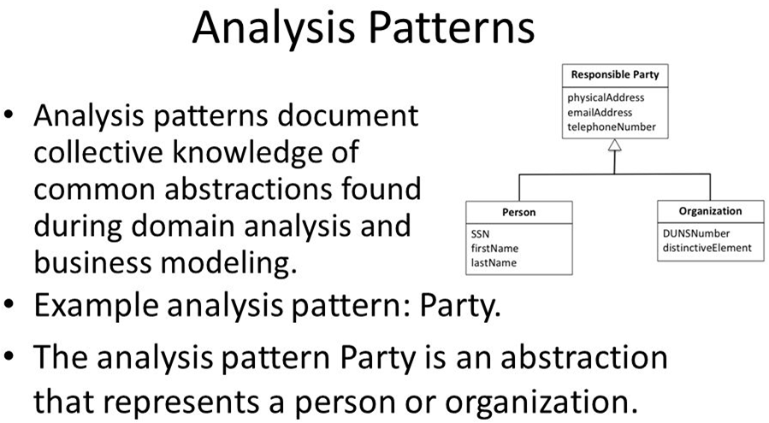

Slide 27
Analysis Patterns: to Reuse Solutions
Pattern name: A descriptor that captures the essence of the pattern.
Intent: Describes what the pattern accomplishes or represents
Motivation: A scenario that illustrates how the pattern can be used to address the problem.
Forces and context: A description of external issues (forces) that can affect how the pattern is used and also the external issues that will be resolved when the pattern is applied.
Solution: A description of how the pattern is applied to solve the problem with an emphasis on structural and behavioral issues.
Consequences: Addresses what happens when the pattern is applied and what trade-offs exist during its application.
Design: Discusses how the analysis pattern can be achieved through the use of known design patterns.
Known uses: Examples of uses within actual systems.
Related patterns: On e or more analysis patterns that are related to the named pattern because (1) it is commonly used with the named pattern; (2) it is structurally similar to the named pattern; (3) it is a variation of the named pattern.

Slide 28
Negotiating Requirements
Even after inception, elicitation and elaborations, customer requirements are still not sufficient in details to proceed to next activity.
Stakeholders need to balance functionality, performance and other product or system characteristics against cost and time-to-market.
Thus, negotiation is to develop a project plan that meets stakeholder needs while at the same time reflecting the real-world constraints such as time, people and budget.
Identify the key stakeholders
These are the people who will be involved in the negotiation
Determine each of the stakeholders “win conditions”
Win conditions are not always obvious
Negotiate
Work toward a set of requirements that lead to “win-win” for all concerned including the software team.

Slide 29
Validating Requirements - I
Is each requirement consistent with the overall objective for the system/product?
Have all requirements been specified at the proper level of abstraction? That is, do some requirements provide a level of technical detail that is inappropriate at this stage?
Is the requirement really necessary or does it represent an add-on feature that may not be essential to the objective of the system?
Is each requirement bounded and unambiguous?
Does each requirement have attribution? That is, is a source (generally, a specific individual) noted for each requirement?
Do any requirements conflict with other requirements?

Slide 30
Validating Requirements - II
Is each requirement achievable in the technical environment that will house the system or product?
Is each requirement testable, once implemented?
Does the requirements model properly reflect the information, function and behavior of the system to be built.
Has the requirements model been “partitioned” in a way that exposes progressively more detailed information about the system.
Have requirements patterns been used to simplify the requirements model. Have all patterns been properly validated? Are all patterns consistent with customer requirements?

